Slide 1
UNIT III
Sensor and Interfacing: Introduction to sensors. Transducers, Classification, Roles of sensors in IOT, Various types of sensors, Design of sensors, sensor architecture, special requirements for IIOT sensors, Role of actuators, types of actuators. Hardwire the sensors with different protocols.

Slide 2
Introduction to sensors
Here is the list of Sensors most commonly use in the IoT devices,
Temperature Sensor
Pressure Sensor
Proximity Sensor
Accelerometer and Gyroscope Sensor
IR Sensor
Optical Sensor
Gas Sensor
Smoke Sensor

Slide 3
Temperature Sensor
A Temperature Sensor senses and measures the temperature and converts it into an electrical signal.
They have a major role in Environment, Agriculture and Industries. For example, these sensors can detect the temperature of the soil, which is more helpful in the production of crops.

Slide 4
There are many types of temperature sensors and the common use are NTC thermistor, Resistance Temperature Detectors RTDs, Thermocouples and Thermopiles.
They are efficient, easy to install and reliable that responds to human activity

Slide 5
Pressure Sensor
A pressure sensor senses the pressure applied ie, force per unit area, and it converts into an electrical signal.
It has high importance in weather forecasting. There are various Pressure sensors available in the market for many purposes.

Slide 6
For example, if there are any water leaks in the residential or commercial areas, a pressure sensor needs to be installed to check if there are any leaks and measures the pressure.
Another eg, all the smartphones, wearables have these barometric pressure sensors integrated into them.

Slide 7
Proximity Sensor
A proximity sensor is a sensor able to detect the presence of nearby objects without any physical contact.
A proximity sensor often emits an electromagnetic field or a beam of electromagnetic radiation and looks for changes in the field or return signal.

Slide 8
A most common application of this sensor is used in cars. While you are taking the reverse, it detects the objects or obstacles and you will be alarmed.
Also, it is used in retails, museums, parking in airports, malls, etc.

Slide 9
Accelerometer and Gyroscope Sensor
The difference between Accelerometer and the gyroscope is accelerometer measures linear acceleration based on vibration whereas, the gyroscope intended to determine an angular position based on the principle of the rigidity of space.
Accelerometers in mobile phones detect the orientation of the phone.
The gyroscope, adds an additional dimension to the information supplied by the accelerometer by tracking rotation or twist.

Slide 10
A 3D gyroscope has three gyroscopic sensors mounted orthogonally.
Accelerometers and gyroscopes are the sensors of choice for acquiring acceleration and rotational information in drones, cell phones, automobiles, aeroplanes, and mobile IoT devices.

Slide 11
Infrared Sensors
An Infrared Sensor is an electronic device, which senses certain characteristics of its surroundings by emitting Infrared radiation.
Has the ability to measure the heat, emitted by an object and also measures the distance.
It implements in various applications. Its uses in Radiation thermometers depend on the material of the object.

Slide 12
IR sensors also use in Flame monitors and moisture analysis.
IR sensors are used in gas analyzers which use absorption characteristics of gases in the IR region.
Two types of methods are used to measure the density of gas such as dispersive and nondispersive.
IR imaging devices are used for thermal imagers and also for night vision.

Slide 13
Optical Sensors
The Optical Sensors convert light rays into an electronic signal, it measures a physical quantity of light and transforms into a form which is readable, maybe digital form.
Detects the electromagnetic energy and sends the results to the units.
It involves no optical fibres. It is a great boon to the cameras on mobile phones. Also, it is used in mining, chemical factories, refineries, etc.
LASER and LED are the two different types of the light source.

Slide 14
Optical sensors are integral parts of many common devices, including computers, copy machines (Xerox) and light fixtures that turn on automatically in the dark.
And some of the common applications include alarm systems, synchros for photographic flashes and systems that can detect the presence of objects.

Slide 15
Gas Sensor
A Gas Sensor or a Gas detector is a device that detects the gas in an area, which is very helpful in safety systems. It usually detects a gas leak in an area, that results sent to a control system or a microcontroller, that finally shuts down. it can detect combustible, flammable and toxic gases.

Slide 16
Transducers
A transducer is an electronic device that converts energy from one form to another. Common examples include microphones, loudspeakers, thermometers, position and pressure sensors, and antenna.

Slide 17
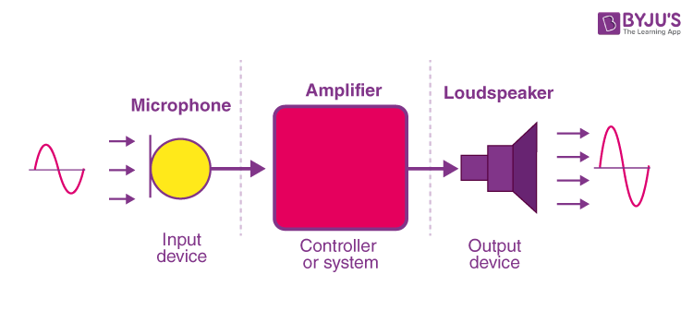

Slide 19
Roles of sensors in IOT
Internet-of-Things (IoT) is revolutionizing the way smart sensors are capable of sensing, diagnosing, deciding, and actuating in a communicative and collaborative way, leading society towards a digitalized new era.

Slide 20
Various types of sensors
Temperature Sensor.
Proximity Sensor.
Accelerometer.
IR Sensor (Infrared Sensor)
Pressure Sensor.
Light Sensor.
Ultrasonic Sensor.
Smoke, Gas and Alcohol Sensor.

